Slide 1


Violation Detection using AI كشف المخالفات باستخدام الذكاء الاصطناعي
Faculty of Computers and Information, Assiut University

Slide 2


Slide 3
Table of Contents:
Introduction
Solutions That Currently Exist
Our Solution
Description Of The Idea
Key Features Of Our Project

Slide 4
Why Did We Use This Idea?
What is the benefit to society from this idea?
Prototype and Output
The Tools Used
Team Members
References

Slide 5
Introduction

Slide 6
The transportation network in Egypt faces a pressing challenge characterized by rampant violations resulting from drivers' disregard for traffic signals and regulations.
This problem has significant repercussions on road safety, efficiency of transportation systems, and overall societal well-being.
Despite the presence of established traffic laws and regulations, the persistent failure of drivers to adhere to these guidelines poses a considerable threat to public safety and infrastructure integrity.

Slide 7
In this presentation,
we will delve into the multifaceted nature of the issue, exploring its root causes, widespread implications, and potential solutions.
Through a comprehensive analysis, we aim to shed light on the urgency of addressing traffic violations in Egypt and outline strategies to foster a culture of compliance, enhance road safety, and optimize the efficiency of the transportation network.
By tackling this problem head-on, we can pave the way for a safer, more sustainable, and seamlessly connected transportation infrastructure in Egypt.

Slide 8
Solutions That Currently Exist

Slide 9
Public Awareness Campaigns:
Solution: Launching educational campaigns to raise awareness about the importance of adhering to traffic regulations, highlighting the risks associated with violations, and promoting responsible driving behavior.

Slide 10
Shortcomings: While awareness campaigns can be effective in informing the public about traffic laws, their impact on actual behavior change may be limited, especially among habitual offenders. Additionally, sustaining interest and engagement in such campaigns over the long term can be challenging, and reaching all segments of the population may prove difficult.

Slide 11
Driver Education and Training Programs:
Solution: Introducing comprehensive driver education programs in schools, providing refresher courses for existing drivers, and incorporating driver safety training into licensing requirements.

Slide 12
Shortcomings: While education and training initiatives can instill a greater understanding of traffic laws and safe driving practices, their impact may be limited if not complemented by other interventions addressing societal attitudes, cultural norms, and economic factors influencing driving behavior. Moreover, implementing widespread training programs can be resource-intensive and may not yield immediate results in terms of reducing traffic violations.

Slide 13
Investment in Infrastructure and Technology:
Solution: Upgrading road infrastructure, implementing intelligent transportation systems (ITS) equipped with real-time monitoring and traffic management capabilities, and introducing smart traffic signals to optimize traffic flow and reduce congestion.

Slide 14
Shortcomings: While improving infrastructure and deploying advanced technologies can contribute to overall road safety and efficiency, the high costs associated with implementation and maintenance may pose challenges, particularly in resource-constrained environments. Moreover, the effectiveness of such measures may be contingent upon drivers' willingness to cooperate and adapt to new systems, which cannot be guaranteed.

Slide 15
Our Solution

Slide 16
Our solution is to rely on solution No. 3, but correct the shortcomings in this solution.

Slide 17
Description Of The Idea

Slide 18
Our project aims to revolutionize the detection of traffic violations through the implementation of artificial intelligence (AI) technology. Leveraging the state-of-the-art Yolov8 algorithm, we have developed a cutting-edge solution that utilizes camera systems for real-time detection of car violations on roadways.
The Yolov8 algorithm is renowned for its exceptional accuracy and efficiency in object detection tasks, making it an ideal choice for our project. By integrating this advanced algorithm into our system, we can effectively identify a wide range of car violations, including but not limited to speeding, running red lights, illegal parking, and improper lane usage.

Slide 19
Our approach involves deploying camera systems at strategic locations along roadways, highways, and intersections. These cameras continuously capture live footage of traffic flow, which is then processed in real-time by our AI-powered system. Through sophisticated image processing techniques and deep learning algorithms, the system analyzes the video feed, identifies vehicles, and detects instances of violations with remarkable precision.

Slide 20
Key Features Of Our Project

Slide 21
High Accuracy: The Yolov8 algorithm, known for its high accuracy in object detection, ensures reliable identification of car violations with minimal false positives.
Real-time Detection: Our system operates in real-time, allowing for immediate detection and response to violations as they occur, thereby enhancing road safety and enforcement efficiency.
Versatility: The Yolov8 algorithm enables our system to detect various types of car violations, offering a versatile solution adaptable to different traffic scenarios and regulatory requirements.

Slide 22
Scalability: Our project is designed to be scalable, allowing for the deployment of camera systems across diverse road networks and geographic locations, ensuring comprehensive coverage and enforcement capabilities.
User-Friendly Interface: We prioritize user-friendliness in our system interface, providing intuitive dashboards and alerts for law enforcement personnel to efficiently manage and respond to detected violations.
Data Analytics: Our system incorporates data analytics capabilities, enabling the aggregation and analysis of violation data over time. This data-driven approach facilitates informed decision-making, policy formulation, and targeted enforcement strategies.

Slide 23
Overall, our violation detection project using AI and the Yolov8 algorithm represents a groundbreaking advancement in traffic management and enforcement. By harnessing the power of AI and innovative technology, we are poised to make significant strides in improving road safety, enhancing compliance with traffic regulations, and fostering a culture of responsible driving.

Slide 24
Why Did We Use This Idea?

Slide 25
This idea addresses the shortcomings of Solution No. 3
We are working on implementing and applying cameras to detect violations using artificial intelligence at a lower cost.
Instead of importing these systems and cameras from abroad, we can implement them here at a much lower cost.
We will obtain very high accuracy due to the use of this type of algorithm

Slide 26
What is the benefit to society from this idea?

Slide 27
Cost-Efficient Solution: Implementing artificial intelligence (AI) to detect traffic violations offers a cost-effective alternative to traditional enforcement methods such as increased police presence or installing additional surveillance cameras. By leveraging AI technologies, we can achieve greater coverage and accuracy in identifying violations at a fraction of the cost.
Enhanced Road Safety: AI-powered violation detection systems have the potential to significantly improve road safety by promptly identifying and addressing instances of non-compliance with traffic regulations. By automatically flagging violations such as running red lights or speeding, these systems help prevent accidents and mitigate risks to both motorists and pedestrians.

Slide 28
Optimized Resource Allocation: By automating the process of violation detection, law enforcement agencies can allocate their resources more efficiently, focusing on areas with higher incidences of violations or where intervention is most needed. This optimization of resources enables better utilization of manpower and financial resources, ultimately leading to a more effective enforcement strategy.
Promotion of Compliance Culture: The implementation of AI-based violation detection systems sends a clear message to the public about the importance of adhering to traffic rules and regulations. By consistently enforcing penalties for violations, these systems contribute to the cultivation of a culture of compliance, where drivers are incentivized to follow the rules for the collective benefit of society.

Slide 29
Scalability and Adaptability: AI technologies offer scalability and adaptability, allowing violation detection systems to be deployed and customized to suit the unique needs and challenges of different regions or road networks. Whether in urban areas with dense traffic or rural areas with limited infrastructure, AI-powered solutions can be tailored to effectively address specific traffic management requirements.
Continuous Improvement Through Data Analysis: AI-based violation detection systems have the capacity to continuously learn and improve over time through the analysis of data. By leveraging machine learning algorithms, these systems can adapt to changing traffic patterns, identify emerging trends in violations, and refine their detection capabilities for greater accuracy and efficiency.

Slide 30
Prototype and Output

Slide 31
Model:
The following model is a prototype for doing object detection using YOLOv8

Slide 32
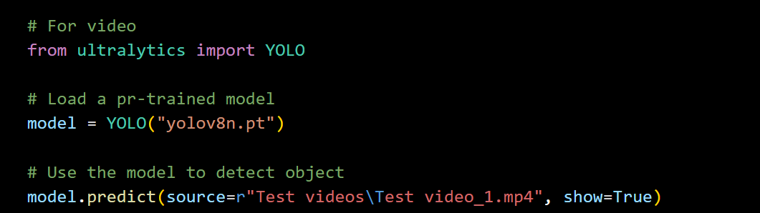

Slide 33
Outputs:

Slide 34
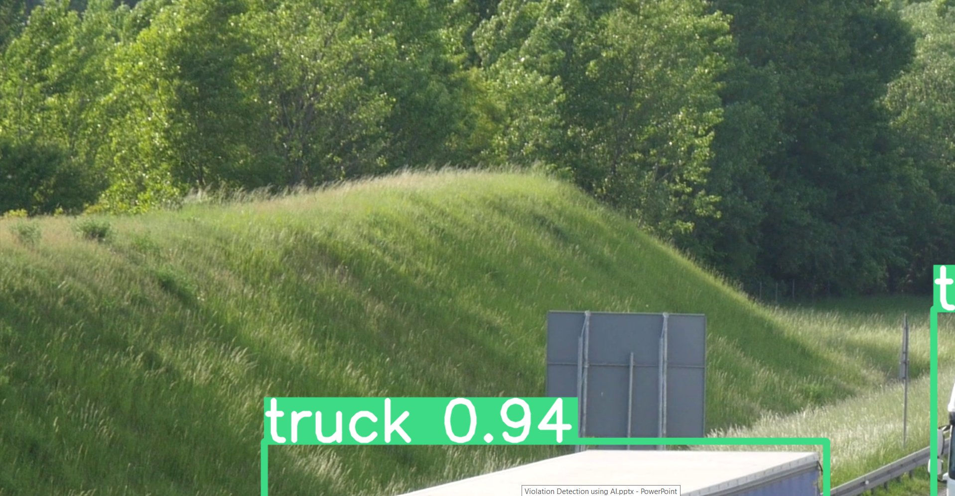
Test 1

Slide 35
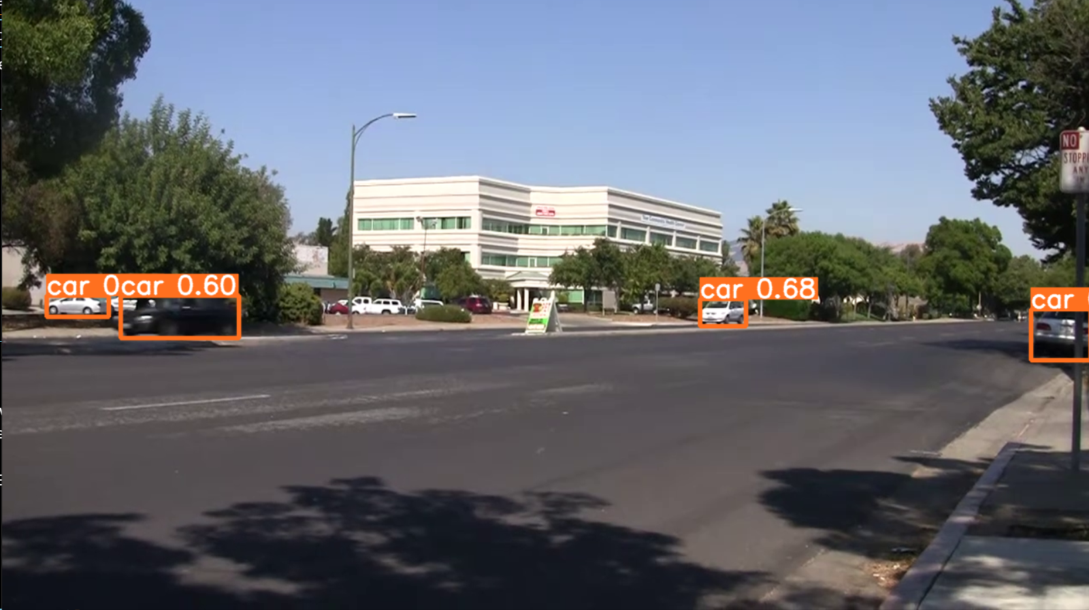
Test 2

Slide 36
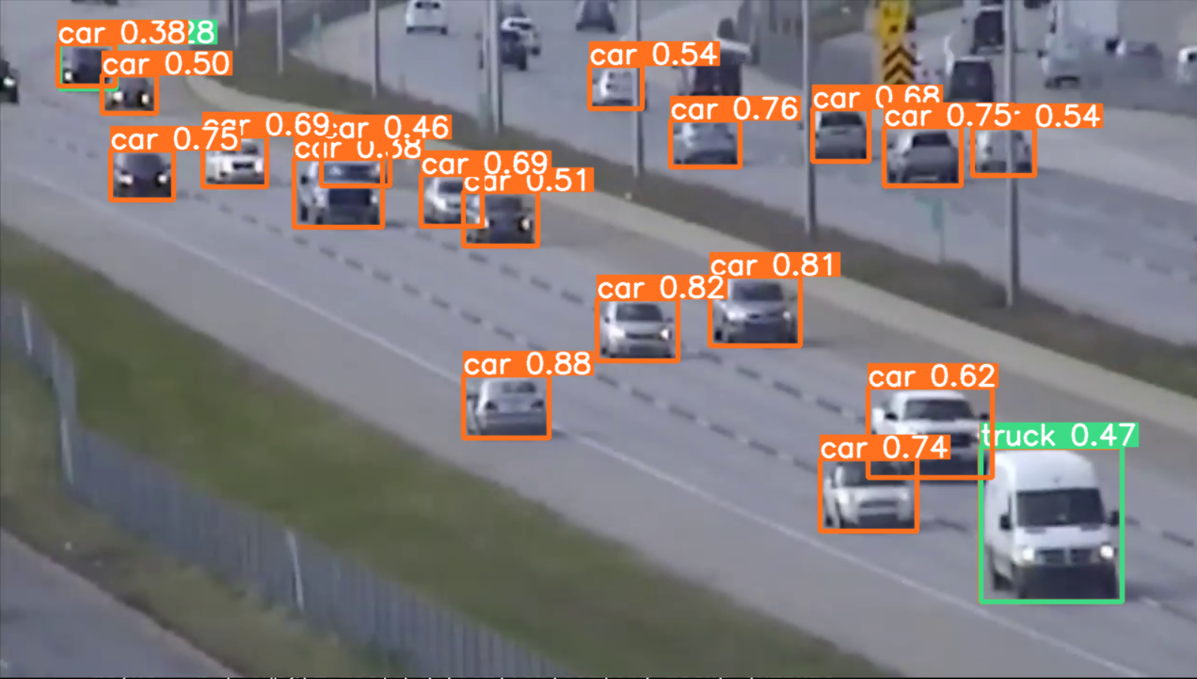
Test 3

Slide 37
Model link on GitHub:
https://github.com/Islam-hady9/Violation-Detection-using-AI.git

Slide 38
The Tools Used

Slide 39
Yolov8 Algorithm: The core component of the project is the Yolov8 algorithm, a state-of-the-art object detection algorithm known for its accuracy and efficiency. Yolov8 is utilized to detect various types of car violations, such as speeding, running red lights, illegal parking, and improper lane usage, from video footage captured by surveillance cameras.
Deep Learning Frameworks: Deep learning frameworks such as TensorFlow or PyTorch are used to implement and train the Yolov8 algorithm. These frameworks provide a flexible and scalable platform for developing complex neural network architectures and optimizing model performance.

Slide 40
Surveillance Cameras: Surveillance cameras equipped with high-resolution sensors and wide-angle lenses are deployed at strategic locations along roadways, highways, and intersections to capture live video footage of traffic flow. These cameras serve as the primary source of input data for the violation detection system.
Hardware Infrastructure: The project requires robust hardware infrastructure to support real-time processing of video streams and execution of AI algorithms. This infrastructure may include powerful CPUs or GPUs, storage servers, and networking equipment capable of handling high-throughput data processing tasks.

Slide 41
Software Development Tools: Various software development tools are utilized for system development, including integrated development environments (IDEs) such as Visual Studio Code or PyCharm, version control systems like Git, and collaboration platforms such as GitHub or GitLab. These tools facilitate code development, collaboration among team members, and project management.
Data Annotation Tools: Annotating training data is a crucial step in training the Yolov8 algorithm. Data annotation tools such as LabelImg, VOTT (Visual Object Tagging Tool), or CVAT (Computer Vision Annotation Tool) are used to annotate objects of interest (e.g., vehicles, traffic signs) in video frames, providing labeled training data for model training.

Slide 42
Cloud Computing Platforms: Cloud computing platforms such as Amazon Web Services (AWS), Google Cloud Platform (GCP), or Microsoft Azure may be utilized for scalable and cost-effective deployment of the violation detection system. These platforms offer services for hosting AI models, managing data storage, and processing video streams in a distributed computing environment.
Database Management Systems (DBMS): DBMS such as PostgreSQL, MySQL, or MongoDB may be employed for storing and managing violation data, metadata, and system logs. These databases enable efficient retrieval, querying, and analysis of data for reporting, monitoring, and decision-making purposes.

Slide 43
User Interface (UI) Tools: User-friendly interfaces are developed using UI frameworks like React.js, Angular, or Vue.js to visualize violation data, display real-time alerts, and provide interactive dashboards for law enforcement personnel. These interfaces facilitate efficient management and response to detected violations.
Monitoring and Logging Tools: Tools for monitoring system performance, logging events, and tracking system health are essential for ensuring the reliability and availability of the violation detection system. Monitoring tools such as Prometheus, Grafana, or ELK Stack (Elasticsearch, Logstash, Kibana) may be employed for this purpose.

Slide 44
Team Members

Slide 45
Mohamed Bassem Mohamed
Islam Abd_Elhady Hassanein Mohamed
Ahmed Maged Hamed
Khaled Ibrahem Aldesouky Elmorshidi gad
Ali Essam abd Elhaleem Ali
Abd Elaziz Elsayed Mohamed

Slide 46
References

Slide 47
Dr. Mahmoud Owais (Faculty of Engineering, Assiut University)
Ultralytics YOLOv8 Docs
Intelligent Traffic Violation Detection
Traffic-Signal-Violation-Detection-System

